Slide 1
Making Books for Younger Children Come Alive: Strategies and Demonstrations
Presented by Karen Gross
Sponsored by MassPTA
Feb. 7, 2022

Slide 2
Pause: Do You Remember?
Memories of being read to by someone(s)
Memories of reading to or with someone(s)
QUERY: Can you name your favorite children’s book – one that you were read to or read with/by children? (KG answers)

Slide 4
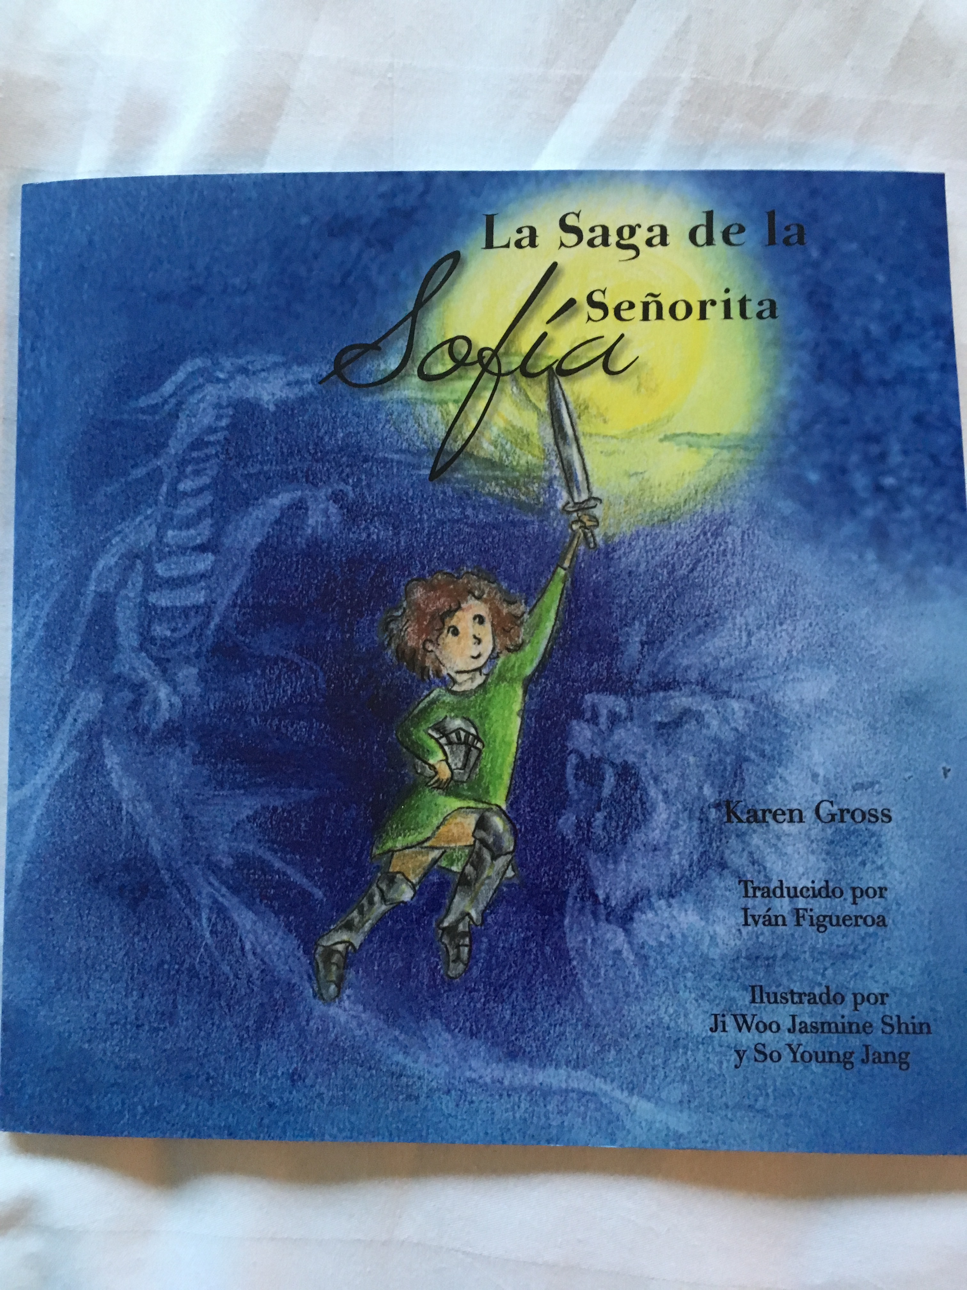
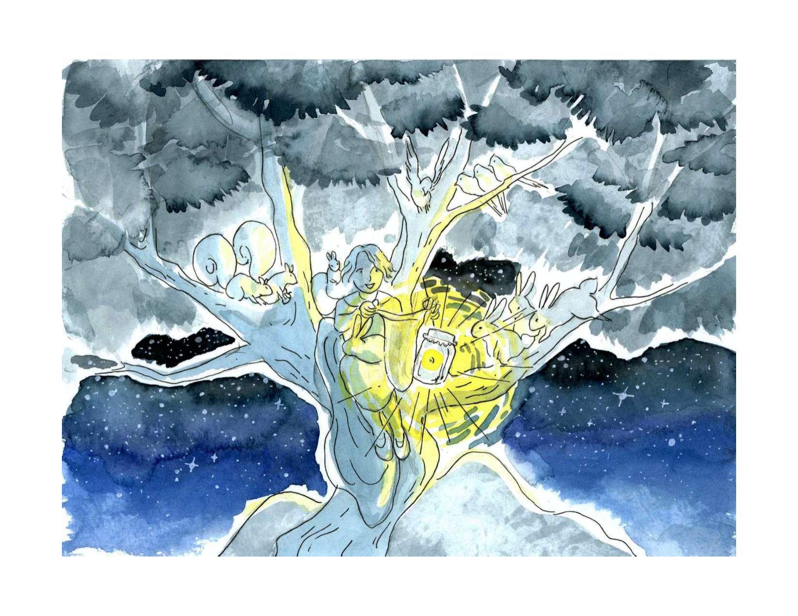
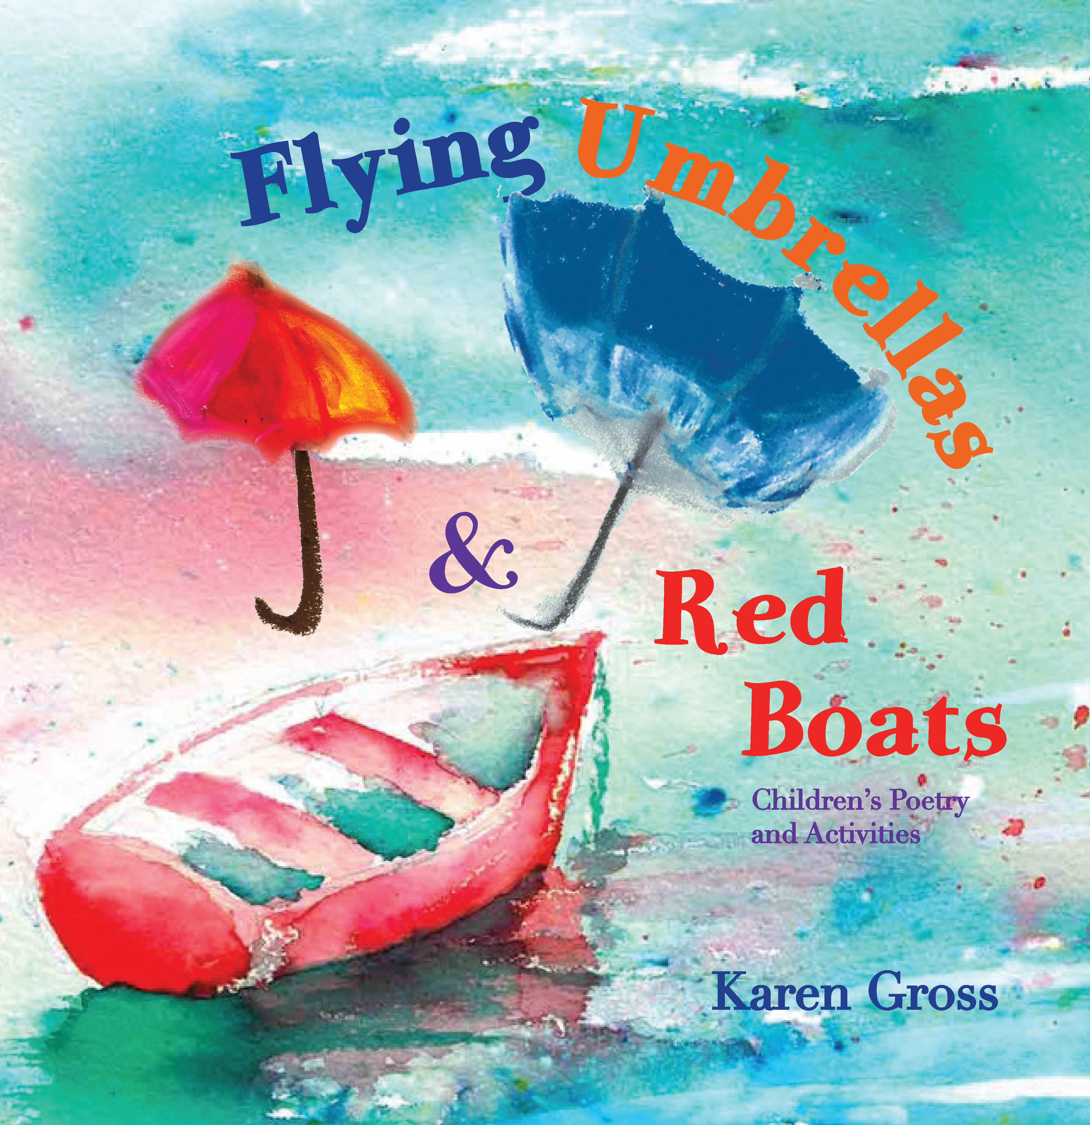
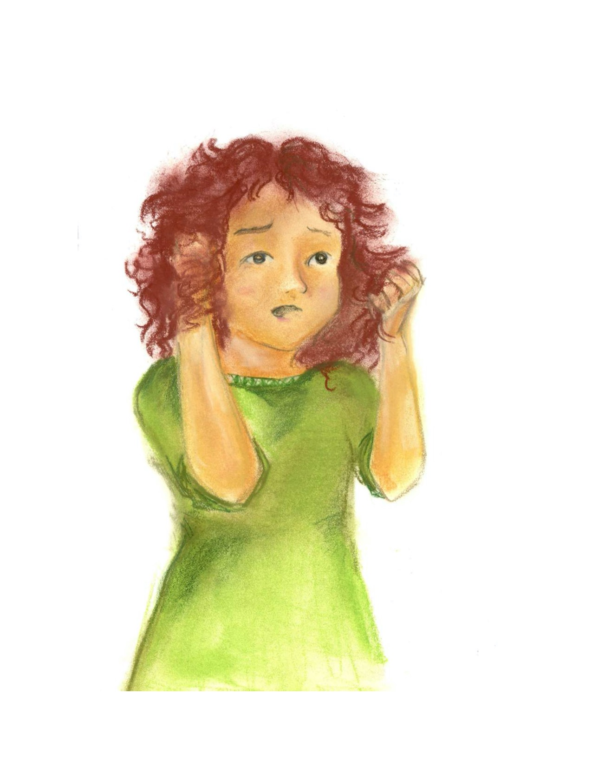
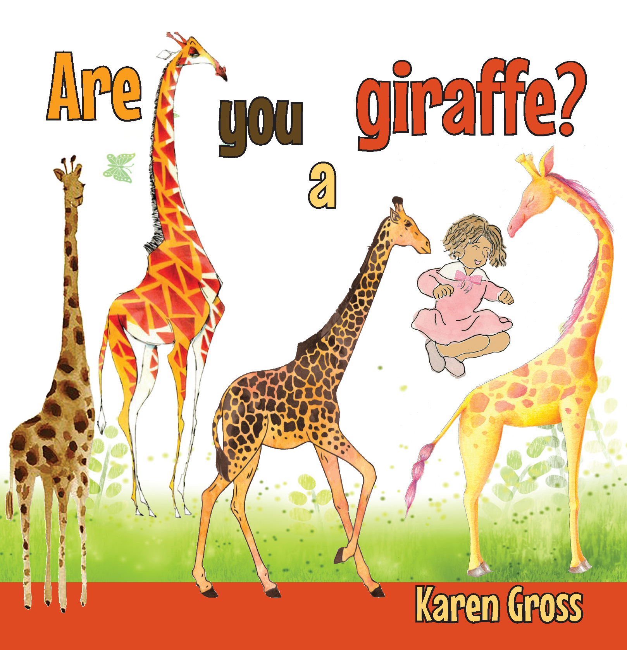
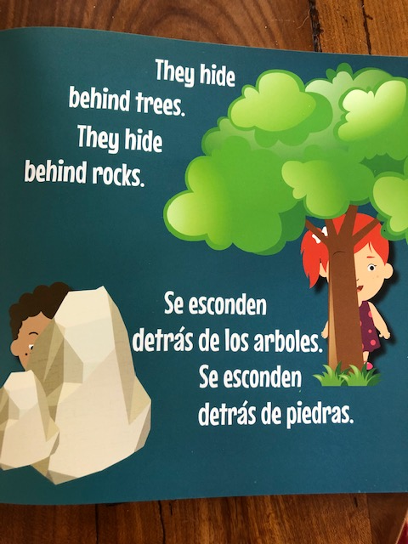
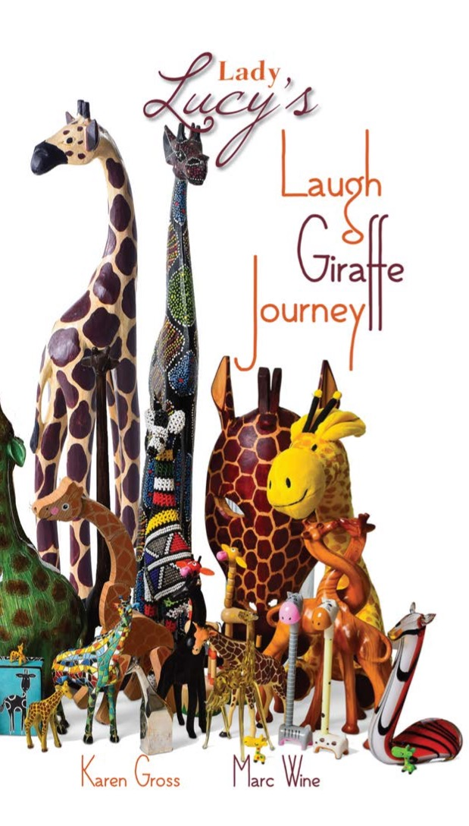
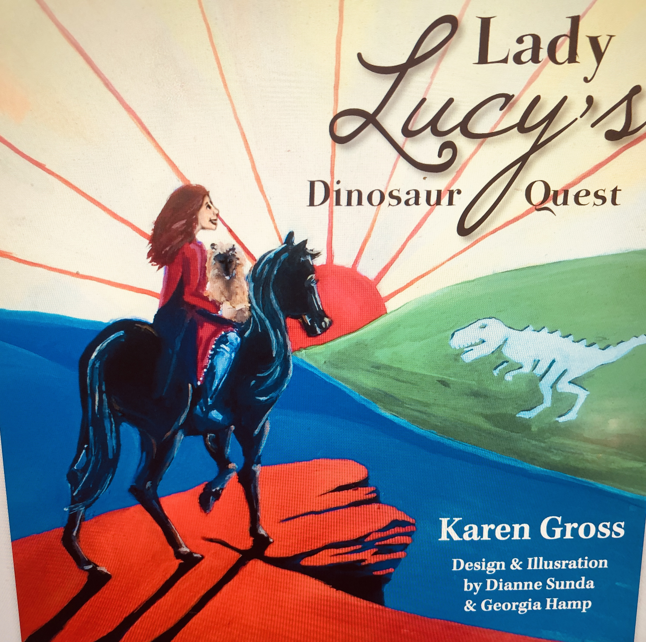
Examples from my Books

Slide 5
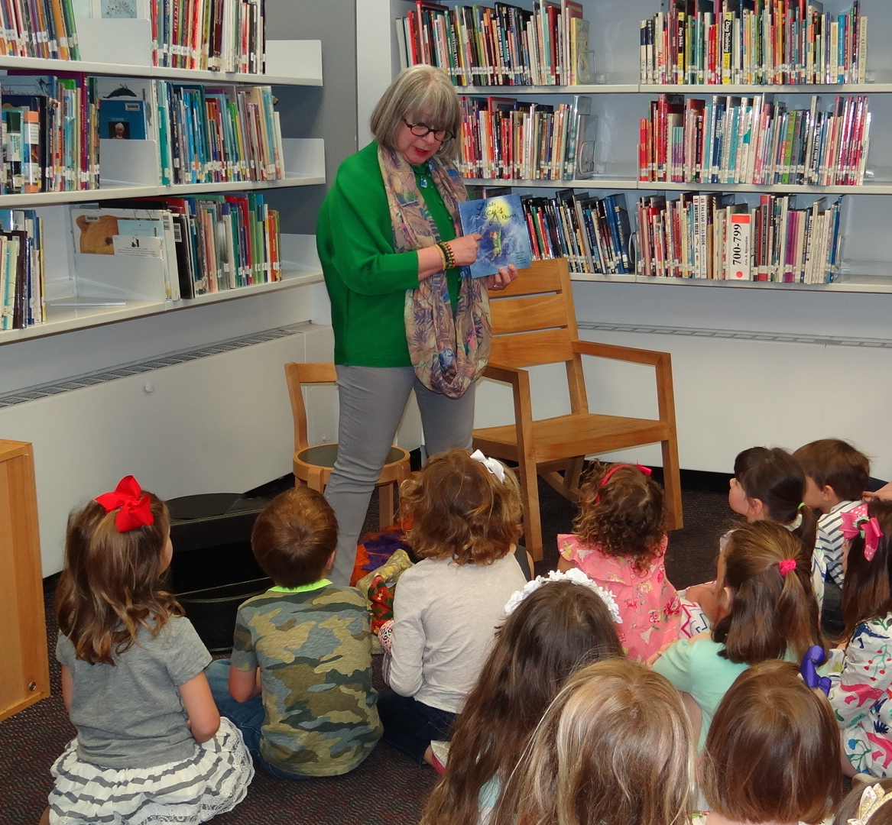
Reading Lady Lucy’s Quest and then Exploring Strategies/Games that Grow from It

Slide 6
Themes, Questions, Games, History: Exemplars that Can Work for Many Books
1. Forming friendships and support when it doesn’t exist at home or in community.
2. What would you put in your sack?
3. Problem Solving Skills
4. The real Lady Lucy and dress-up
5. Puzzles; word/image searches
6. Script; Coloring
7. Medieval history

Slide 7
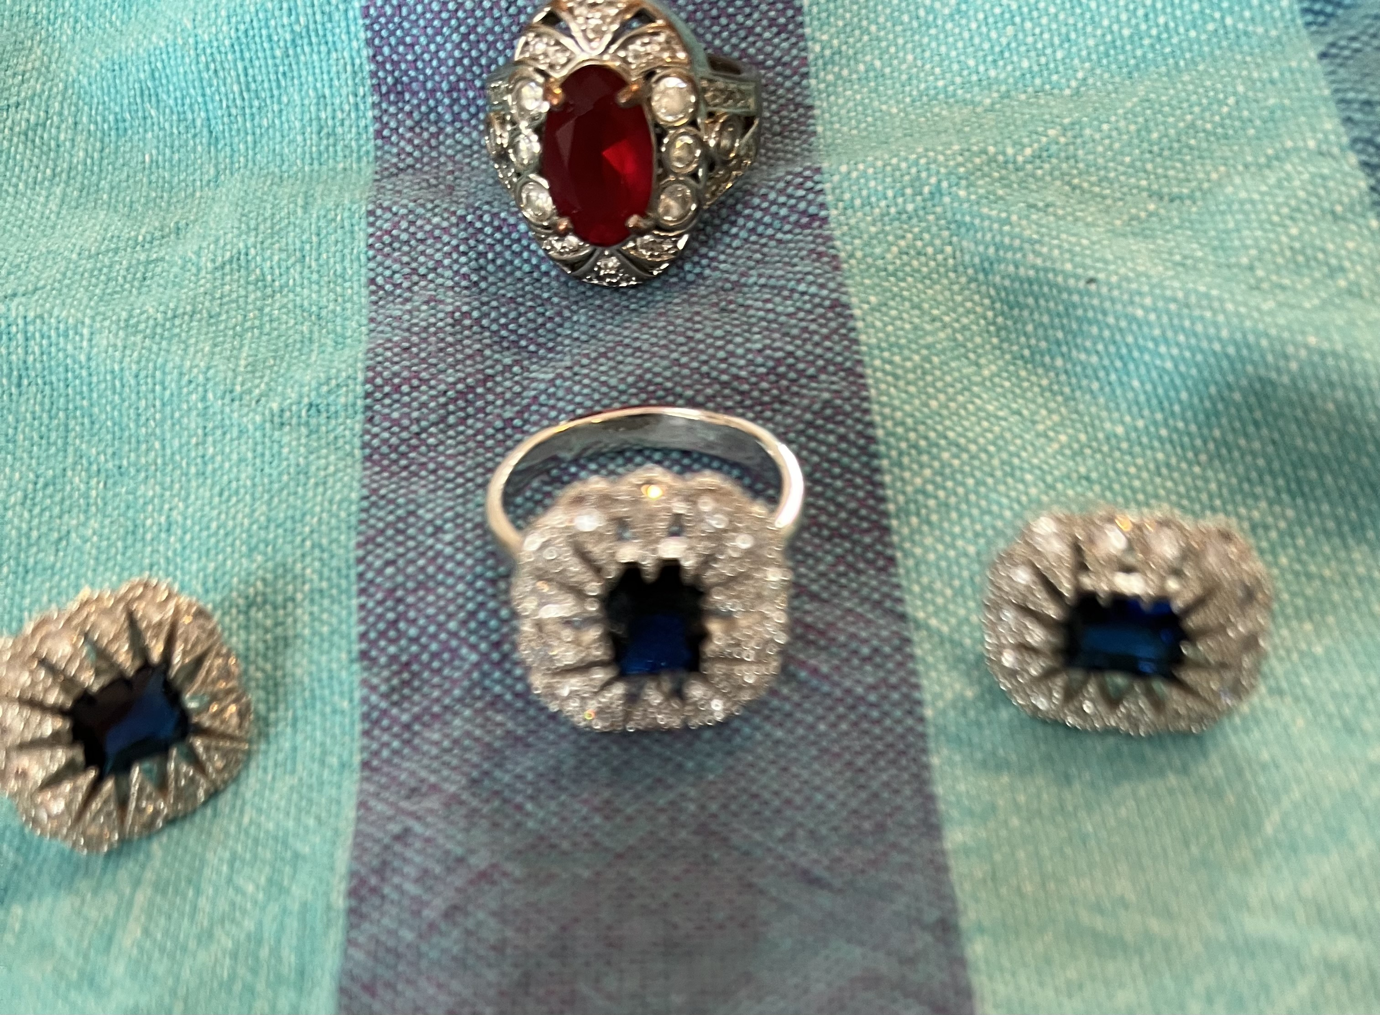
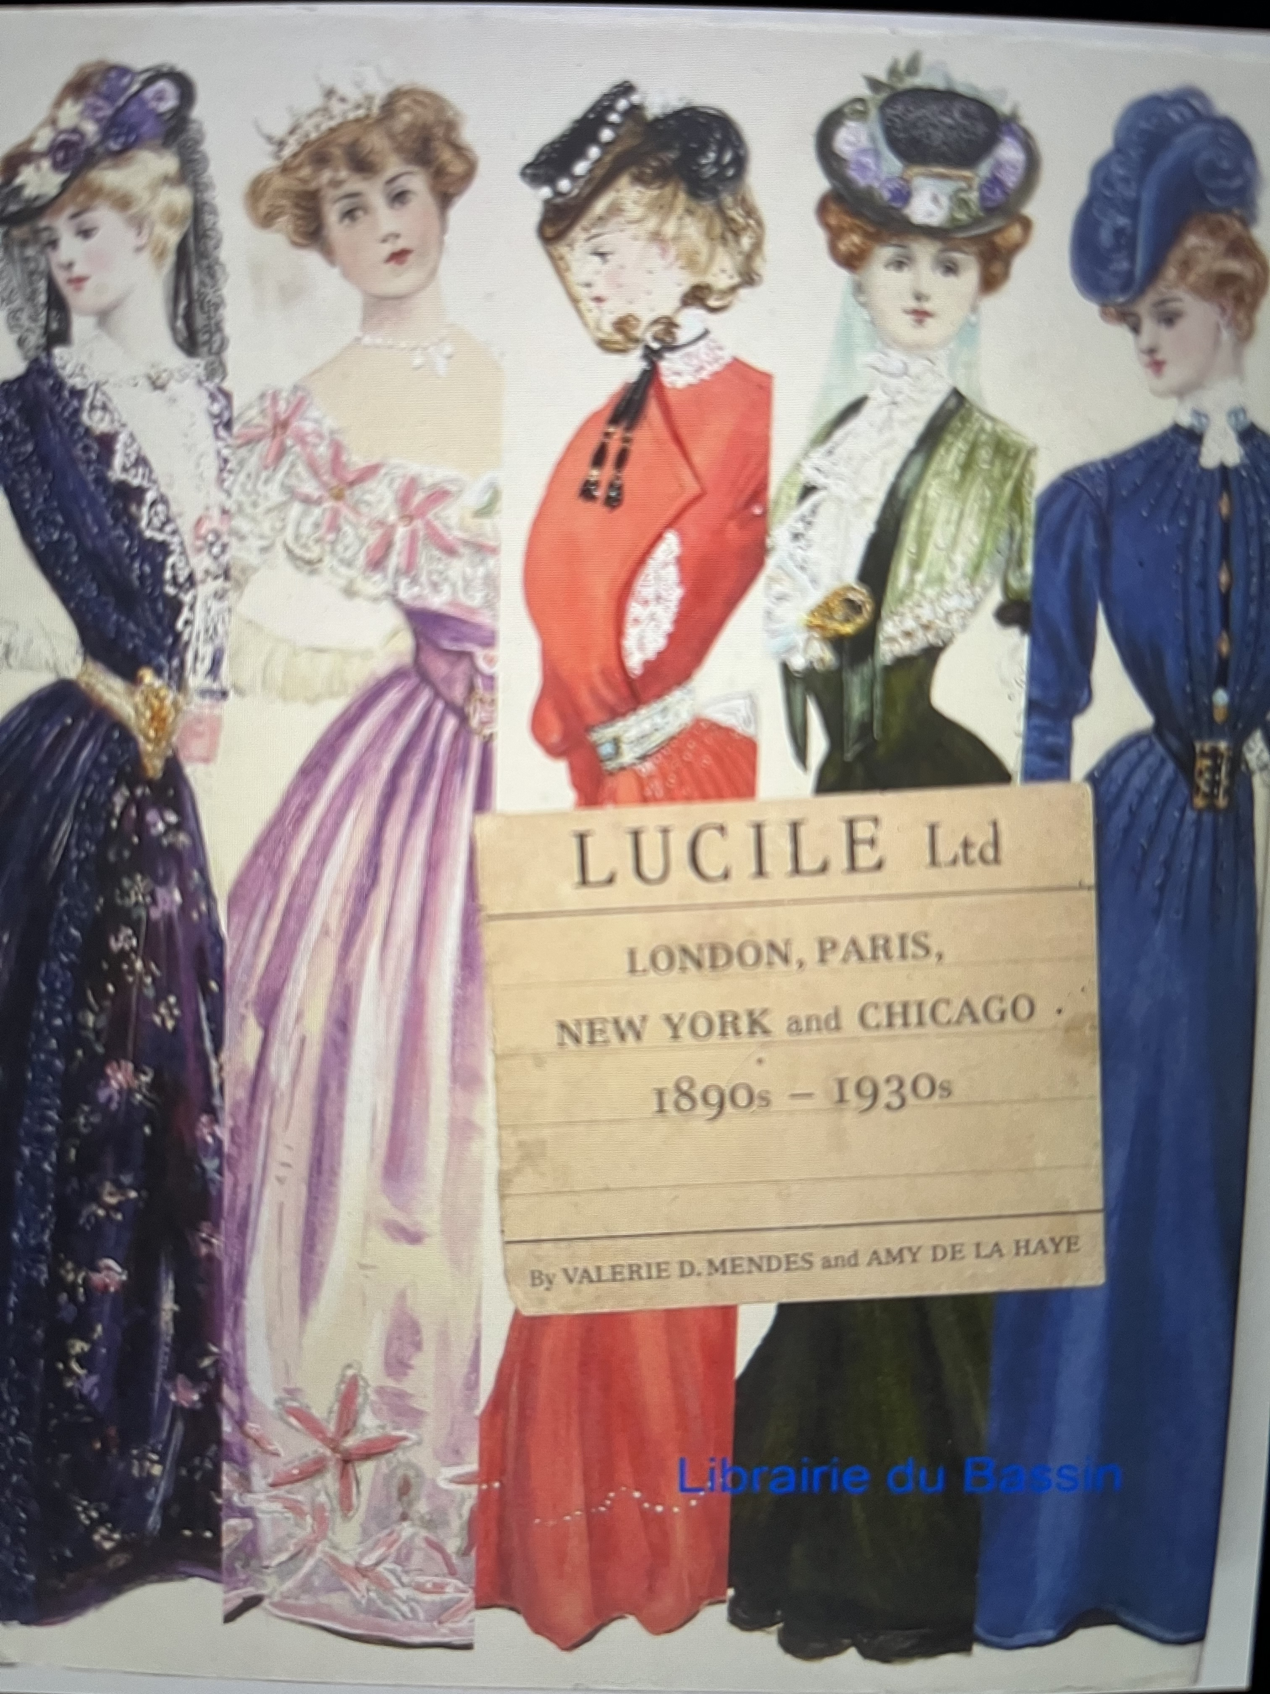
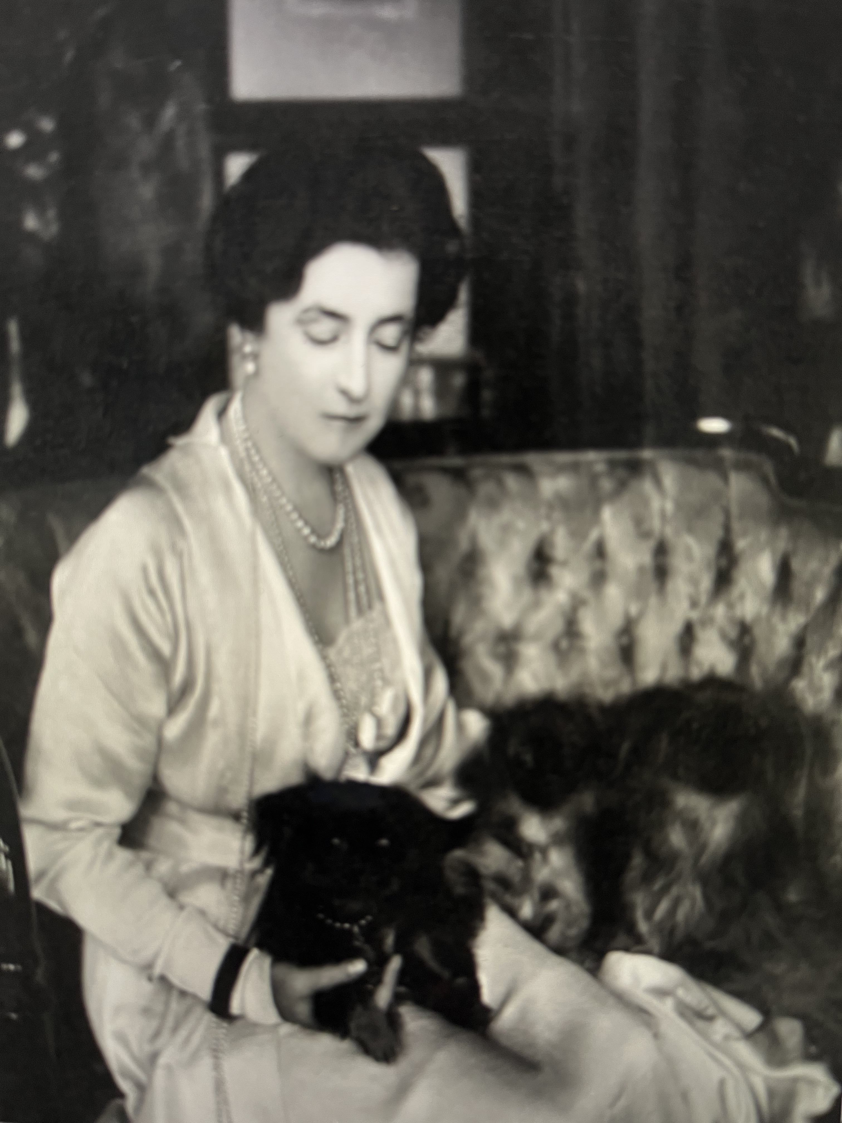
Lady Lucy Duff-Gordon
https://karengrosseducation.com/books/lady-lucys-quest/
https://www.linkedin.com/pulse/sears-catalog-meaning-memory-karen-gross/

Slide 8
Examples from an Activity Book
These can be created on one’s own.
There are online services to create crossword puzzles and word searches
Googling is a good way to learn about the historical aspects

Slide 9
Sample Activities

Slide 10
More

Slide 11
More

Slide 12
Even More

Slide 13
Even More

Slide 14
Questions

Slide 15
Contact Information
www.karengrosseducation.com
karengrosscooper@gmail.com
917-363-4872
Twitter: @KarenGrossEdu
LinkedIn: https://www.linkedin.com/in/karengrossedu/
Facebook: https://www.facebook.com/karen.gross.790
Instagram: karengross2154
Amazon Author: amazon.com/author/karengrossedu

