Slide 1
www.commercialfreechildhood.org
David Monahan
www.screentimenetwork.org
Jean Rogers

Slide 2
98% of households with 2 to 8 year old children have mobile devices: Smart phones Tablets AI devices Music players
75 % increase since 2013: Common place, Normal, Broadly accepted way of life.

Slide 3
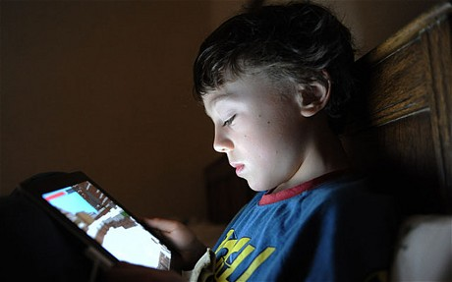
45% of these children have their own personal dedicated device.
Up from just 12% in 2013.

Slide 4
Remove judgment. Technology is not good or bad. It just is.
No guilt. Parenting
Comes with enough.
No
Digital
Judgment
Zone
Notes:
By using Family Engagement Principles and the Protective Factors, we’re able to take the judgment out of it and place it into the category of a child’s health and wellness.

Slide 5
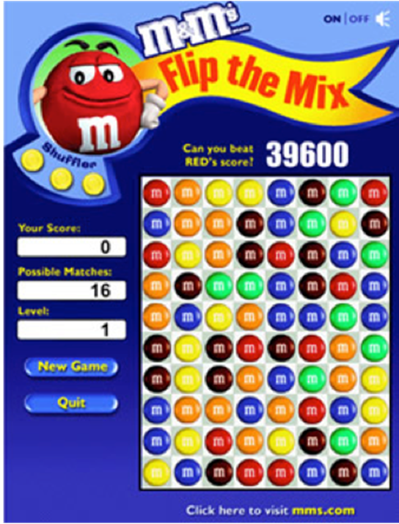
Using characters and persuasive design to pressure our children

Slide 6
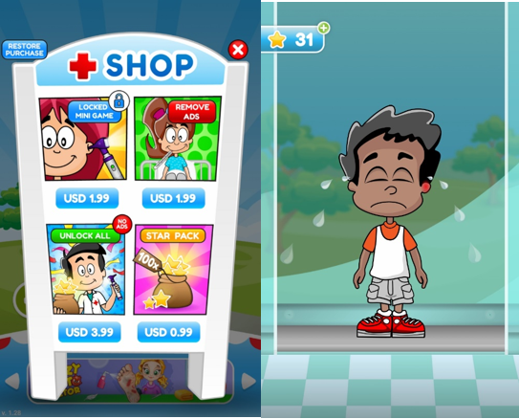

Slide 7
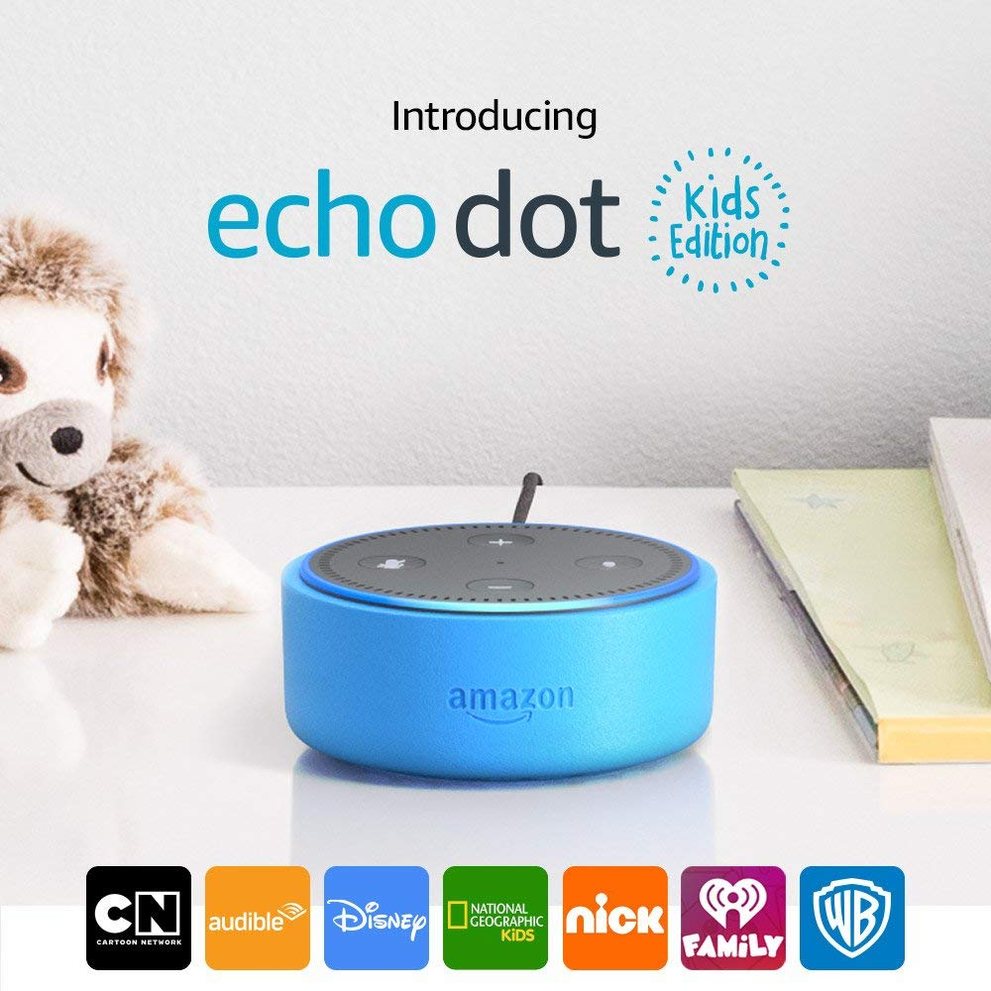
More than four in 10 parents of 6- to 8-year-olds (43 percent) say their children use voice-activated assistants to help with homework. Common Sense Census, 2017 Dot Kids
It’s sturdy! It’s safe! It’s kid-friendly! It’s transaction-free! It’s a marketing device.!
Notes:
At the end of the day, the Echo Dot Kids is a marketing device. It takes advantage of kids’ developmental vulnerabilities, not just to sell them stuff, but to sell them on the idea and practice of corporate surveillance. It embeds Amazon, a private company whose ultimate goal is profit, into the lives of very young children, who are predisposed to trust, and who don’t understand the complexities of data, sharing, surveillance, or advertising. It gives brands unprecedented, around-the-clock, highly personalized access to children, with the express purpose of building brand awareness, engagement, and sales.
All of this is allowed, and even encouraged, by our current technological, economic, and policy climate. Powerhouse companies suck up data, optimizing every interaction to maximize profit. In this regard, Echo Dot Kids is the same as Echo Dot is the same as Google Home is the same as Facebook Portal.
Amazon wants parents to think Echo Dot Kids is different, that it’s made for kids, but it’s not.
It’s made to appeal to kids. It’s made for Amazon.
The only way this will change -- that children’s needs will come before corporate profits -- is through radical action: policy change, meaningful and enforcable regulation, and a broad coalition of developers, technologists, advocates, caregivers, and legislators who choose to put children first.
Until that change comes, parents should avoid Echo Dot Kids.
And if you’re interested in helping us make it happen, I hope you’ll be in touch.

Slide 9
Screen-Free week: May 4 – 7, 2020

Slide 10
www.commercialfreechildhood.org
David Monahan david@commercialfreechildhood.org
www.screentimenetwork.org
Jean Rogers
jean@commercialfreechildhood.org

