Slide 1
Massachusetts State Test: What do families need to know?
2015 - 2016
Notes:
[CUSTOMIZE FOR STATE]
[WELCOME SLIDE – TRANSITION AT BEGINNING OF EVENT]

Slide 2
Overview of Discussion
What the new state tests mean for your child
What was your child tested on last year
How to interpret test results
Additional resources for parents
Notes:
[CUSTOMIZE FOR STATE]
Welcome! I’m {Name}, and I’m {Position}. We know many of you wanted to learn more about the [Insert State Test Name] – especially given the changes this year. That’s why PTA and {School} partnered to host this information night for families – parents and guardians – to learn the basics about the tests, as well as ways you can help prepare your children.
Today we will cover:
More information about what the new state test means for your child
What your child can expect
Ways to support your child
How to interpret the results
And additional resources
We’ll begin with a presentation and then have a question and answer session.
At this time, I’d like to welcome {Name}, {Title}, who will share more about the assessments.
[INSERT BIO SLIDE WITH NAME/PHOTO OF SPEAKER IF SPEAKER IS SOMEONE THE AUDIENCE MAY NOT KNOW, SUCH AS A SCHOOL DISTRICT LEADER]

Slide 3
What the New State Tests Mean for Your Child
Notes:
CUSTOMIZE TITLE FOR STATE
Welcome! I’m {Name}, and I’m {Position}.
{Insert comments about importance of families knowing more about the standards, curriculum and state assessments as families are the most important education partner. Thank the audience for taking the time to learn more – and support their children’s academic success.}

Slide 4
New Statewide Tests
New standards require new state tests that better measure these skills and allow students to show what they know and what they can do.
The PARCC tests replaced the previous tests in English and Math and are one of several measure of how well a student is progressing against the new standards.
Results from the tests can be used to let teachers know where students are doing well or where they need support.
Notes:
Massachusetts adopted more rigorous standards for students to better prepare them for the future. New standards meant Massachusetts needed a new test that was aligned to these standards so we could see how our students were progressing.
For more information on the standards at every grade level, check out the Parents’ Guides for Student Success on the PTA website listed on your handout.

Slide 5
What is PARCC?
The Partnership for Assessment of Readiness for College and Careers
A group of states that have worked together to develop high quality tests in English and Math that are aligned to the new standards.
Massachusetts joined PARCC to create a new test aligned to our standards. Massachusetts state officials gave districts the opportunity to administer the PARCC test or the MCAS.
Students in grades 3-8 will take the English Language Arts and Mathematics tests during a 30 day window.
Notes:
PARCC (The Partnership for Assessment of Readiness of College and Careers) is a group of states that joined together to develop state tests that were aligned to higher standards. PARCC created a modern test to replace old state tests in Math and English. The PARCC tests gives parents and teachers better information on where students are excelling or need more help.
Massachusetts joined the PARCC consortium to develop a new test in English language arts and Math. Massachusetts teachers reviewed test questions, and reading passages, and were involved in the development of the test. Massachusetts state officials gave districts the opportunity to administer the PARCC test or the MCAS.
After listening to feedback from parents, teachers and the community the PARCC governing board voted to reduce the testing time for students by about 90 minutes overall (60 minutes in mathematics; 30 minutes in English language arts) and consolidate the testing windows in mathematics and English language arts/literacy (which includes reading and writing) into one.
Students in grades 3-8 will take the test in English language arts and math. The testing window will be up to 30 days and will extend from roughly the 75% mark to the 90% mark of the school year. Most schools will complete testing in one to two weeks during that window.

Slide 6
What Was My Child Tested on Last Year?
Notes:
Let’s talk a little bit about the tests.

Slide 7
What’s Different About the Tests?
The new tests go beyond the “bubble test.”
Students show their work through:
Extended writing and multi-step questions which require students to apply the skills they have learned.
They are tests worth taking. Students spend time reading complex text, writing well-organized responses and solving real world problems.
They measure:
Problem-solving
Writing
Critical thinking
Reading Comprehension
Notes:
The test included writing tasks and multi-step problems, which measure critical thinking, problem solving and real world skills. These questions are hand scored. The test also includes end-of-year tests which are more traditional test questions. They are made up of innovative, short-answer questions to measure student understanding of both concepts and skills and are computer-scored.

Slide 8
What Were Students Tested on in English?
Could students read closely to comprehend a range of complex literary and informational texts?
Could students write effectively for a range of purposes and audiences?
Could students listen effectively for a range of purposes?
Could students use research skills to investigate topics, analyze, and present information?
Notes:
The new PARCC tests measured progress on the skills outlined in the standards. For example, in English Language Arts – could students read and comprehend texts literary and informational texts? Could they write and listen effectively? Could they research a topic and effectively present their findings?

Slide 9
EXAMPLE: 5th Grade ELA Test
New Massachusetts State Test Example:
You have read two texts about famous people in American history who solved a problem by working to make a change.
Write an article for your school newspaper describing how Eliza and Carver faced challenges to change something in America.
In your article, be sure to describe in detail why some solutions they tried worked and others did not work.
Tell how the challenges each one faced were the same and how they were different.
.
Notes:
[CUSTOMIZE SLIDE & SCRIPT FOR STATE]
In this example, you’ll see how much deeper students need to go to read, comprehend, and write an answer.
[READ QUESTION]
Students read more complex texts and then they are asked to write about them. They are also reading informational text, and learning about history, science, health, or other life-relevant topics. Then they write with a purpose – thinking about a problem, analyzing what happened, and considering possible solutions.
Students demonstrate comprehension, writing skills, and ability to analyze and think critically about problems and solutions

Slide 10
What Were Students Tested on in Math?
Could students explain and apply math concepts and perform math procedures?
Could students solve problems using their knowledge of concepts and problem solving strategies?
Could students analyze real-world scenarios and create models to solve problems?
Could students build practical arguments to support their own reasoning?
Notes:
In Math, students were asked complex questions and asked to explain their answers. They also were asked to apply mathematical concepts, and use their understanding of these concepts along with problem solving strategies to solve real-world problems. Not only did they have to solve the problems, but in some cases, they were asked to create models of how they solve it. In the higher grades, students created mathematical arguments to support their reasoning.

Slide 11
EXAMPLE: 5th Grade Math Test
New Massachusetts State Test Example:
Mr. Edmunds shared 12 pencils among his four sons as follows:
Alan received 1/3 of the pencils
Bill received 1/4 of the pencils
Carl received more than 1 pencil
David received more pencils than Carl
PART A: On the number line, represent the fraction of the total number of pencils that was given to both Alan and Bill combined. Use the buttons on the right to increase or decrease the number of equal sections on the number line.
PART B: What fraction of the total number of pencils did Carl and David each receive? Justify your answer.
.
Notes:
[CUSTOMIZE SLIDE & SCRIPT FOR STATE]
[READ QUESTION; GIVE A FEW MINUTES. GIVE PRIZE FOR CORRECT ANSWERS]
There are no random selections, which means students cannot use guesswork. They have to apply what they know about number sense to solve the problem, show their work and explain their answer. It will take students more time per question than simply choosing the best answer.

Slide 12
How To Interpret Test Results
Notes:
After the test, you are wondering – what does this all mean? How does this help my child?

Slide 13
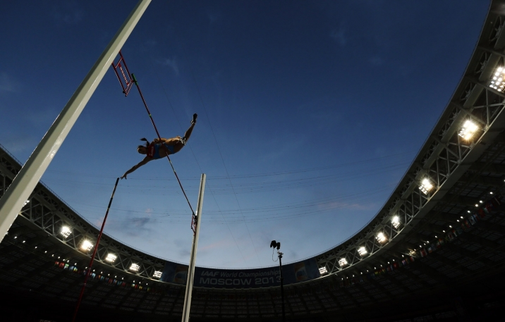
New Tests New Baselines
This year’s scores are setting a new baseline so progress can be measured moving forward.
We cannot compare the previous tests to PARCC.
We expect scores to look lower, but it does not mean students did not make progress.
This is a transition year.
Notes:
Simply put, these tests are harder. Students will be answering more complex questions and solving more complex problems, which was not required on the previous state tests, but gives us the useful information about student progress (that you saw on the previous slide) that was not possible before. Because they are harder, scores may look lower than before.
This does not mean that students learned nothing or scored lower. We have raised the bar for our students by requiring them to understand concepts more deeply. We cannot compare the old tests, which measured student progress, to the new tests, which holds them to a much higher bar. The scores aren’t higher or lower, they are simply different because we are measuring different things.
Change is hard, and just as our students will be adjusting to the new test, educators and leaders will need time to transition to the test to fulfill its promise.

Slide 14
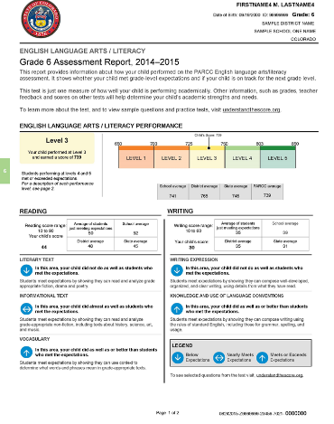
What Will Results Look Like?
The score report breaks down your child’s performance into categories. This is important because it lets teachers know where a student is excelling and where to target instruction.
Notes:
The PARCC score reports were designed to provide better information on how your child is progressing and where he or she might need more help. Score reports for both English Language Arts and Math will give an overall measure of how your child performed individually and when compared to other students in the state, and across other PARCC states.
The reports will also include how well your child performed in each of several categories, and a description of the category. This is the actionable information that can be used to help ensure there aren’t any learning gaps. And if they are falling behind, it ensures that students can get help immediately.

Slide 15
How Will Scores be Used?
Test results will help schools to:
Make instructional decisions.
Guide teacher’s instruction.
Identify the needs of students:
Do they need extra support?
Do they need more challenging work?
Recommendations for future classes?
Scores will not impact a student’s GPA or report card grade.
They are only one measure of student achievement.
Notes:
The test results will allow parents, teachers, and students to know whether students are on track each year as they prepare for new academic material. The goal is to ensure that we know when students need more challenging work or more support. This will help your child to get a more personalized education that will best fit their needs. You will also be able to compare your student’s performance with students in other schools, districts, and states. The test scores do not impact GPA, class ranking, or college acceptance.

Slide 16
Thank You To Our Teachers
A Transition:
Learning the new standards
Engaging lessons
Helped develop the PARCC test
Notes:
SPEAKER TURNS PRESENTATION BACK OVER TO PTA REPRESENTATIVE
The PTA believes that every child deserves a high-quality education to give them the opportunity to reach their full potential. To do this, we need high-quality tests that tell us what children know and can do and where they need more help.
We know that teachers have been working very hard over the past few years. They have spent hours attending trainings on the new standards and worked with each other to develop creative, engaging lessons based on the standards. This has been and continues to be a transition for teachers as well. We would like to thank them for all their hard work implementing the new standards, and supporting students as they now transition to new assessments! It could not be possible without you!

Slide 17
Resources for More Information
Notes:
[SAY]
Tonight, we are only scratching the surface and I’m sure many of you have more questions. So we have a number of handouts that you can take with you to reference. I’d also like to point you to some great websites that have more information.

Slide 18
How Do I Know What My Child is Expected to Learn This Year
The PTA developed grade-specific “Guides to Student Success” so you know the skills your child should master and what he or she is expected to know every year:
www.PTA.org/CommonCore
Notes:
These guides detail what your child should be working on in every grade in Mathematics and English Language Arts.

Slide 19
Where Can I Find More Info?
Great Web Sites
PARCC Practice Tests: Reading, Writing, Math
www.PTA.org/CommonCore
Practice Tests http://parcc.pearson.com/practice-tests/
Parent Friendly Information and Resources:
[Name of State Department of Education] [Insert State DOE website]
Tutorials http://parcc.pearson.com/tutorial/
PARCC Info: www.parcconline.org
[Insert State PTA Name] : [Insert State PTA Website]
Grade level and subject Learning Tools: http://bealearninghero.org/learning-tools
Building skills: http://bealearninghero.org/skill-builder
Notes:
Visit the PARCC site where you will find practice tests, tutorials, and more specific information about test formats and features.
You can also find parent-friendly information on BeALearningHero.org and on the [Insert State Department of Education Name] website.
Finally, visit PTA’s Common Core web pages where you will find guides, videos, webinars, etc. The [Insert State PTA name] also has information on its Web site.
Now I’d like to open it up for questions.

Slide 20
Questions?
Notes:
[SEE ANTICIPATED QUESTIONS IN DIGITAL TOOLKIT TO SUPPORT YOUR RESPONSES]

